Slide 1
REST & RESTfulness - API Design Principles
Protocols

Slide 2
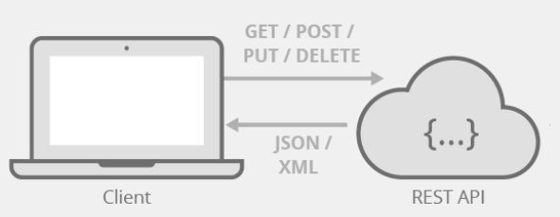
What is REST?
Deﬁnition: REST (Representational State Transfer) is an architectural style for designing networked applications.
Key Idea: Uses standard HTTP methods and stateless communication.
Origin: Coined by Roy Fielding in his 2000 dissertation.

Slide 3
Why REST Matters?
Simplicity & Scalability: Based on standard HTTP.
Interoperability: Works across diﬀerent platforms.
Eﬃciency: Uses caching, statelessness for performance.

Slide 4
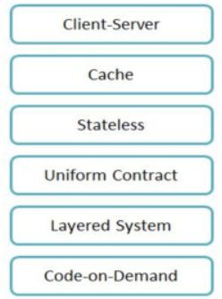
REST Constraints (Core Principles)
Client-Server Architecture
Statelessness
Cacheability
Layered System
Uniform Interface

Slide 5


RESTful API Design Principles
Resource-Based Approach
  GET /users/{id} to retrieve a user
  POST /orders to create a new order
Proper HTTP Methods Usage
  GET to retrieve data
  POST to create new resources
  PUT to update existing resources
  PATCH for partial updates
  DELETE to remove resources
Stateless Interactions
Consistency in URL Structure
Use plural nouns for collections: /users, /orders
○
○
Avoid including actions in URLs: /users/{id}/activate
Implement versioning for backward compatibility: /v1/users
→ /users/{id} with PATCH

Slide 6
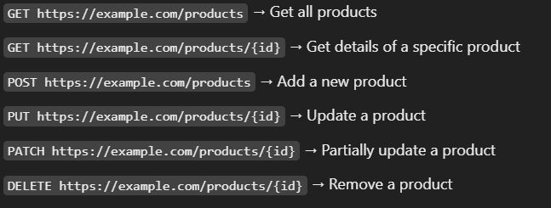
Resources & Endpoints
Resources: Entities like Users, Orders, Products.
Endpoint Examples:
  GET /users/{id}
  POST /orders
  DELETE /products/{id}

Slide 7

JSON vs. XML in REST APIs
Why JSON?
  Lightweight
  Faster parsing
  Readable
When to Use XML?
  Legacy systems
  Data validation needs

Slide 8
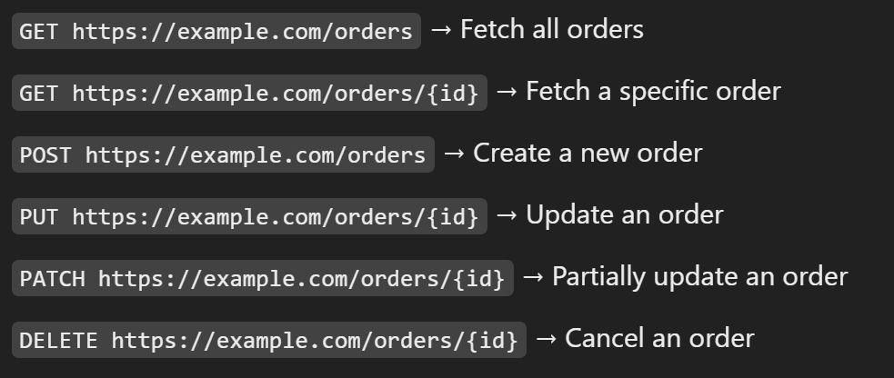
HTTP Methods in REST
GET: Retrieve data
POST: Create a resource
PUT: Update a resource
PATCH: Partial update
DELETE: Remove a resource
OPTIONS, HEAD: Additional functionalities

Slide 9
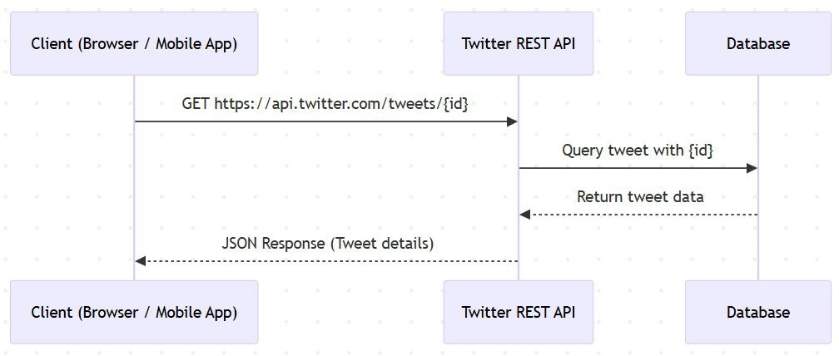
Real-World REST API Examples
Twitter API
  Fetch tweets: GET /tweets/{id}
  Post a tweet: POST /tweets
GitHub API
  Get repo details: GET
/repos/{owner}/{repo}
  Create an issue: POST
/repos/{owner}/{repo}/issues

Slide 10

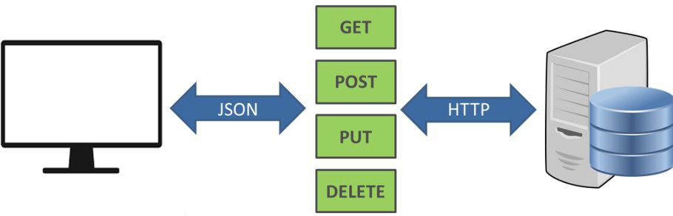
Best Practices & Common Pitfalls
Use Proper Status Codes (200, 201, 400, 404, 500)
Versioning APIs (/v1/resource) Implement Authentication (OAuth, JWT) Pagination (?page=2&limit=20)
Avoid using Verbs in URLs (/createUser → POST /users)

Slide 11
Interview Questions - REST
Basic Questions
  What is REST, and how does it diﬀer from SOAP?
  What are the six constraints of REST architecture?
  What is the diﬀerence between a REST API and a RESTful API?
  What is a resource in REST, and how is it represented?
  What are endpoints in a REST API?
TP Methods & Status Codes
  Explain the diﬀerence between GET, POST, PUT, PATCH, and DELETE.
  When would you use PUT vs. PATCH?
  What are the commonly used HTTP status codes in REST APIs?
  What does the 200 OK, 201 Created, 204 No Content, 400 Bad Request, 401 Unauthorized, 403 Forbidden, 404 Not Found, and 500 Internal Server Error mean?
RESTful API Design & Best Practices
What are the best practices for designing RESTful APIs?
How do you design a RESTful API for a blogging platform (e.g., users, posts, comments)?
What is HATEOAS (Hypermedia as the Engine of Application State) in REST?
How do you handle authentication and authorization in REST APIs?
What are API rate limiting and throttling, and why are they important?
○
How do you ensure backward compatibility when updating a REST API?
Advanced & Real-World Questions
  How does caching work in RESTful APIs?
  What is the diﬀerence between JSON and XML in REST?
  How do you implement pagination in REST APIs?
  How does versioning work in REST APIs?
  Explain the diﬀerences between REST, GraphQL, and gRPC.
  How would you improve the performance of a REST API?
  Can a REST API be stateful? Why or why not?
  How does REST handle security vulnerabilities like SQL injection and CSRF?

Slide 12
Summary & Key Takeaways
REST is a stateless, scalable, and widely adopted API design style.
Proper endpoint structure, HTTP methods, and response formats matter.
Security, versioning, and best practices improve API quality.
What’s next:
  Real-Time Communication Protocols

